Slide 2
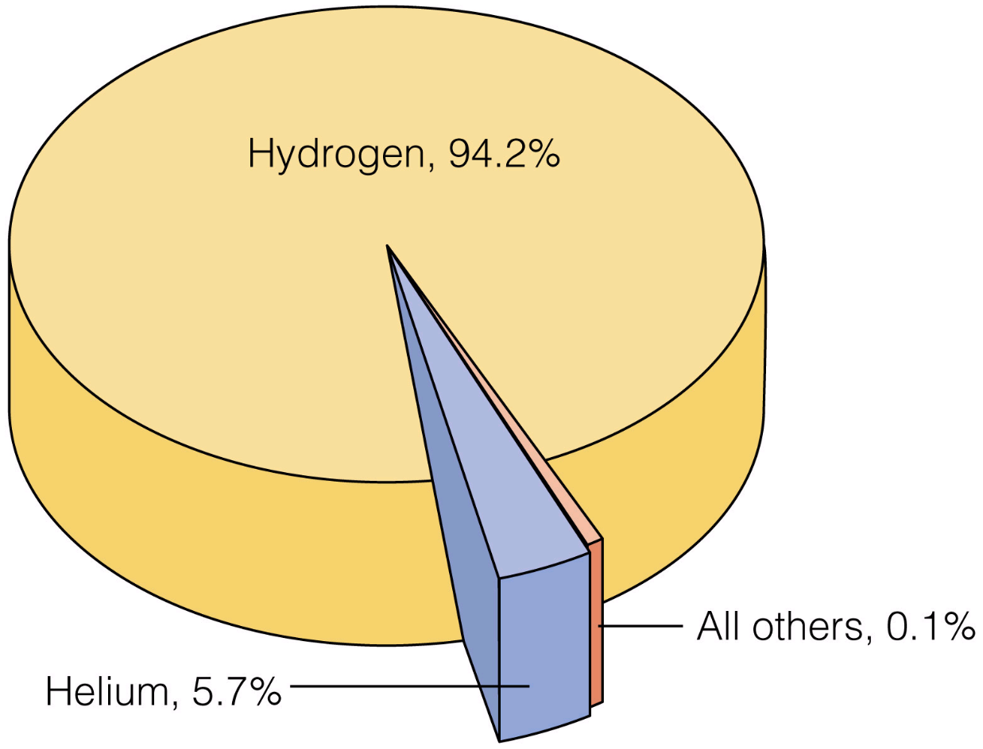
Abundance of the Elements
UNIVERSE by atom

Slide 3
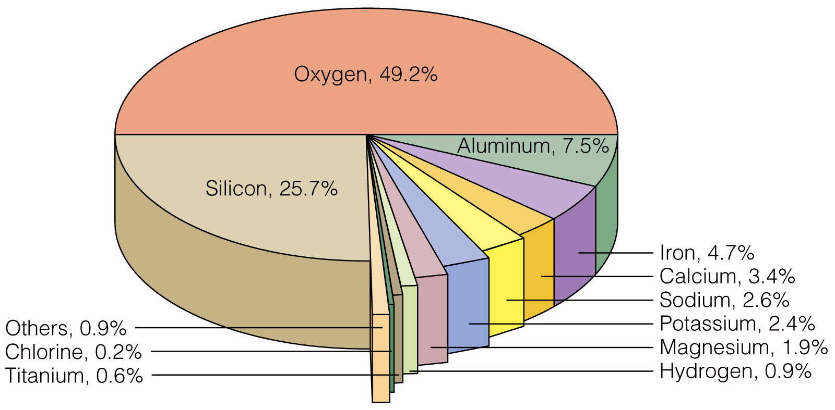
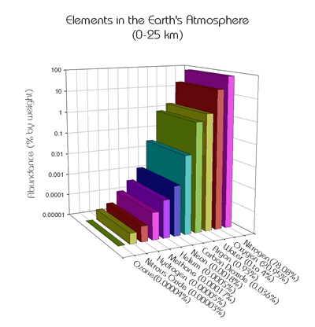
Abundance of the Elements
CRUST
OCEAN
ATMOSPHERE by mass
ATMOSPHERE 78% N₂ and 21% O₂

Slide 4
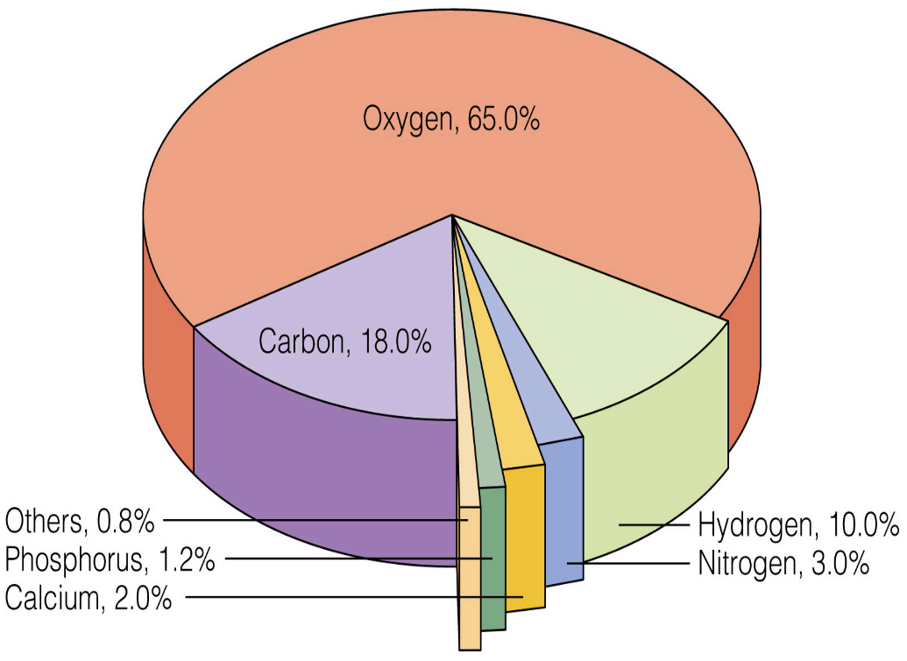
Abundance of the Elements on EARTH
BODY by mass
BODY by atom

Slide 5
ELEMENTS
Elements are designated by:
- A single word name.
- A one or two letter symbol, where the first letter is capitalized
Memorize the names and symbols for the 1st 36 elements.

Slide 6
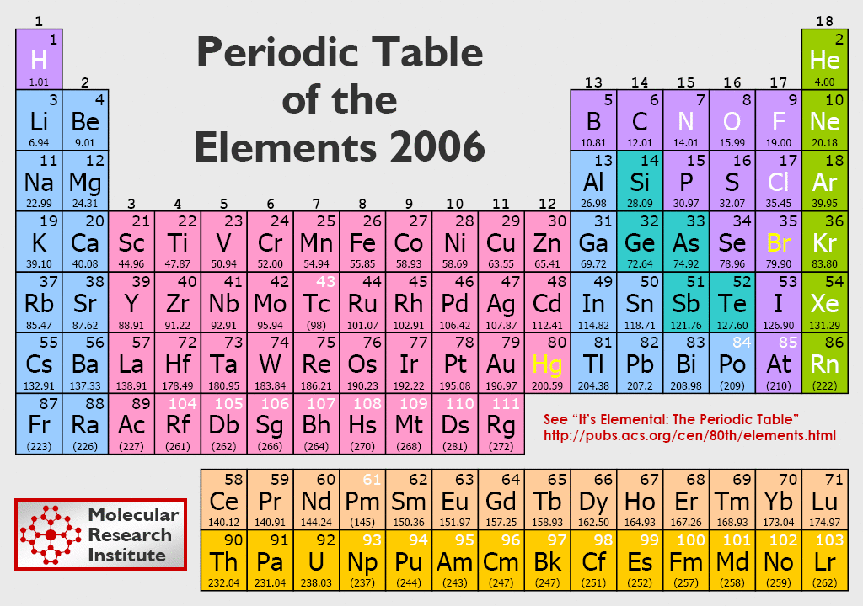
4.9 Elements
Memorize the names and symbols of the 1st 36 elements

Slide 7
Elements
Memorize the names and symbols of the 1st 36 elements
and the following 8 common elements:
Ag silver
Sn tin
I iodine
Ba barium
U uranium
Au gold
Hg mercury
Pb lead

