Slide 1
Fluid Mosaic Model of Cell Membranes

Slide 2
Transport Through Cell Membranes
The transport of substances through cell membranes
involves
diffusion (passive transport), which moves particles from a higher to a lower concentration.
facilitated transport, which uses protein channels to increase the rate of diffusion.
active transport, which moves ions against a concentration gradient.

Slide 3
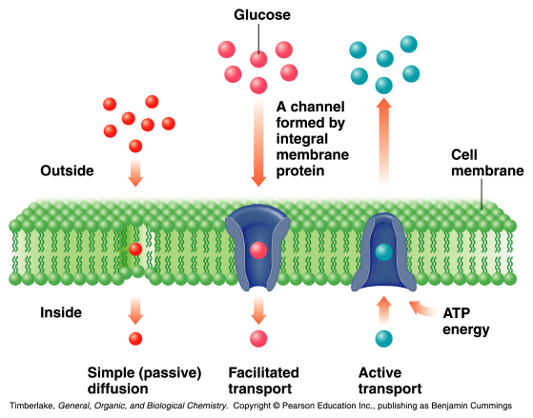
Transport Pathways Through Cell Membranes

