Slide 1
FLASHCARDS
CJS 2-4-13

Slide 2
What are flashcards?
A highly recommended
learning strategy
Notes:
Does everyone know what a flash card is?
Physical appearance
Virtual flashcards
We’ll cover what makes a good flash card later

Slide 3
Has anybody used them?
Notes:
What did you use them for?
I’ve never used them but wished I had?
For learning but what kind of learning? Memorizing terms. The fundamentals. Definitions.
For what classes? Chemistry, physics, math, biology, anatomy, zoology, geology, history, english, psychology, political science, sociology

Slide 4
Why do flash cards work?
Notes:
Writing down facts helps to commit them to memory. Just making flash cards is a learning activity. Finding them on the internet and using them isn’t as good as making your own.
Flashcards are widely used as a learning drill to aid memorization by way of spaced repetition.
Flashcards exercise the mental process of active recall
Metacognitive learning – thinking about thinking- You have to think about your answer-assessment.
USEFULNESS:
Excellent fo Visual learners
OK for auditory learners
Low for kinesthetic learning

Slide 5
Summarizing in ones own words = processing information =
stored memory
Easy and ongoing review.
A question and answer format.
Notes:
Flashcards can bear vocabulary, historical dates, formulas or any subject matter that can be learned via a question and answer format.
Flashcards are widely used as a learning drill to aid memorization by way of spaced repetition.
Flashcards exercise the mental process of active recall
Metacognitive learning – thinking about thinking- You have to think about your answer-assessment.
USEFULNESS:
Excellent fo Visual learners
OK for auditory learners
Low for kinesthetic learning

Slide 6
learning drill to aid memorization
spaced repetition
Practice Testing.

Slide 7
Both spaced-out learning, or distributed practice, and practice tests were rated as having “high utility” by the authors.
http://ideas.time.com/2013/01/09/highlighting-is-a-waste-of-time-the-best-and-worst-learning-techniques/

Slide 8
How are they used?
Video on how to use flashcards.
http://www.youtube.com/watch?v=CS8RZoirLzQ
Notes:
The main principle being spaced repetition – increasing the review interval whenever a card is recalled correctly.
Since flashcard study is so fast and efficient, you can study at any time.
You can whip out your flashcards for a 2 minute study or a 20 minute study.
Keep your flashcards in your pocket or purse at all times. Carry them around. 10 at a time.
Study while waiting in line at the bank.
Study while waiting for someone to arrive at lunch.
Study while riding elevators.
Study on the train
Study in the bathroom
Use them verbally – auditory learning
Set a goal to review each flashcard in your pack 3 times per day.
Tony Robbins says “repetition is the mother of skill.”
Set aside the cards you know ONLY after you can answer them correctly after a night of sleep.

Slide 9
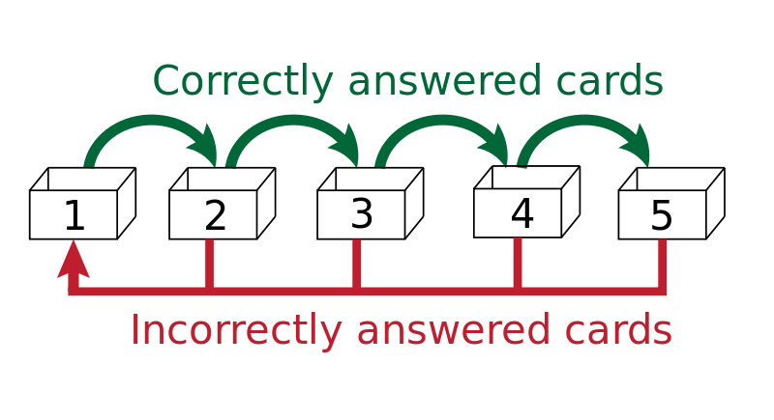
Notes:
This shows a graphic of what the repetition looks like. The intervals should be spaced out as your learning gets better.

Slide 10
How are they made?
Each card should only have 1 question and 1 answer –It should be quick (i.e. “Flash” card) . So 1 question and 1 answer.
Right way: A flashcard that has “Who was the main actor in Mission Impossible” – answer on other side: Tom Cruise.
Wrong way: Who was the main actor, supporting actor, key grip and set designer for the movie Mission Impossible? Answer: Who the hell knows?
- Notice how intimidating this second card is.

Slide 11
Nitrate

Slide 12
Nitrate
Page 235

Slide 13
NO₃⁻

Slide 14
NO₃⁻
Polyatomic anion
Oxy anion

Slide 15
NO₃⁻
Polyatomic anion
Oxy anion
An “ate” anion

Slide 16
CREATE YOUR OWN FLASH CARDS online and share them with your study group via Facebook, etc.
Quizlet
StudyBlue FlashCardMachine.
Course Hero

