Slide 2
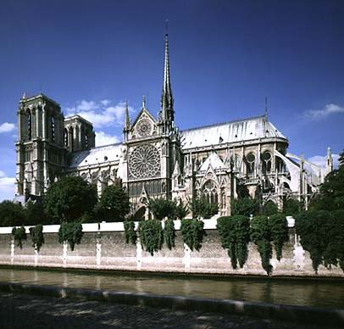
Notre Dame Paris

Slide 3
Organization of the landscape
Most visible element of the religious landscape?
Places associated with the founder
Shrines
Important in the life of Buddha
Miraculous events
Mecca Ka’ba
Remnants of an earlier time (Wailing Wall)

Slide 4
Continued
Churches/Mosques/Temples/Synagogues
Simple to ornate
Icons for some but not others
Pagodas are very ornate
An integral part of the worship; especially for Christians
Churches as the center of a community (literally and figuratively)

Slide 5
Sacred Space
Where the founder lived
Supernatural events
Pilgrimage sites
Lourdes/Mecca
Scared shrine destruction in Iraq
Natural places
Ayers Rock (Australian aboriginals)
Mt Shasta (New Age)
Rivers (Ganges in India sacred to Hindus)

Slide 6
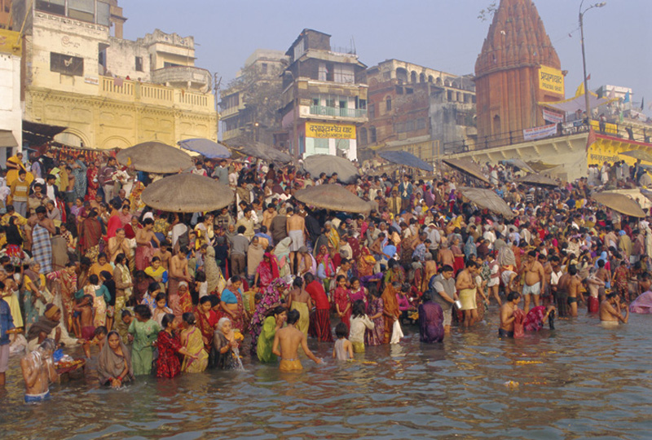
Sacred Landscapes of Hinduism
Hinduism – pilgrimages follow prescribed routes, and rituals are followed by millions.
Varanasi, India on the
Ganges River where Hindus perform morning rituals.

Slide 7
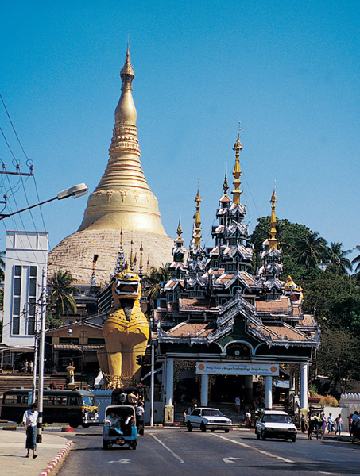
Sacred Landscapes of Buddhism
Swedogon Pagodo in Yangon, Myanmar
Eight hairs of the Buddha are preserved under the dome (chedi)

Slide 8
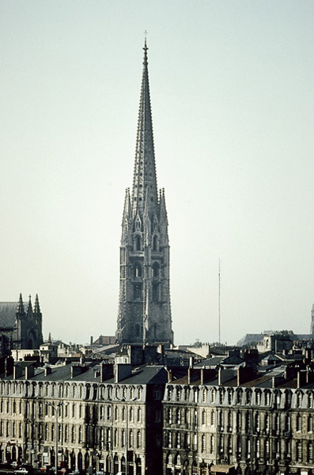
Sacred Landscapes of Christianity
Catholic Churches
Are often located in the center of European cities, with spires reaching far above the other buildings.

Slide 9
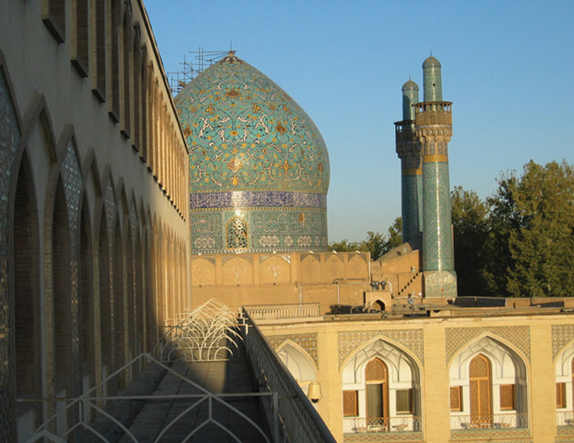
Sacred Landscapes of Islam
Muslim Mosques
Dome of this mosque in Isfahan, Iran demonstrates the importance of geometric art evident in Muslim architecture.

Slide 10
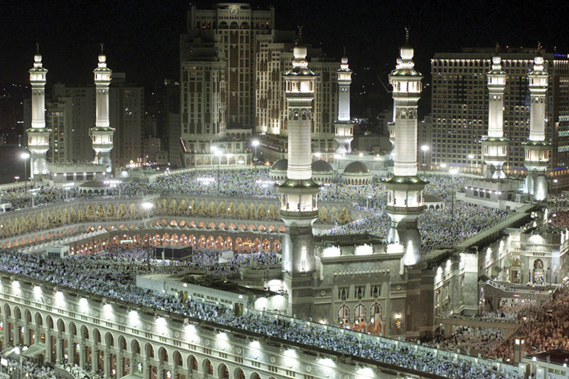
The Hajj Pilgrims circle the holy Kaaba in the Grand Mosque in Mecca, Saudi Arabia during the Hajj.

Slide 11
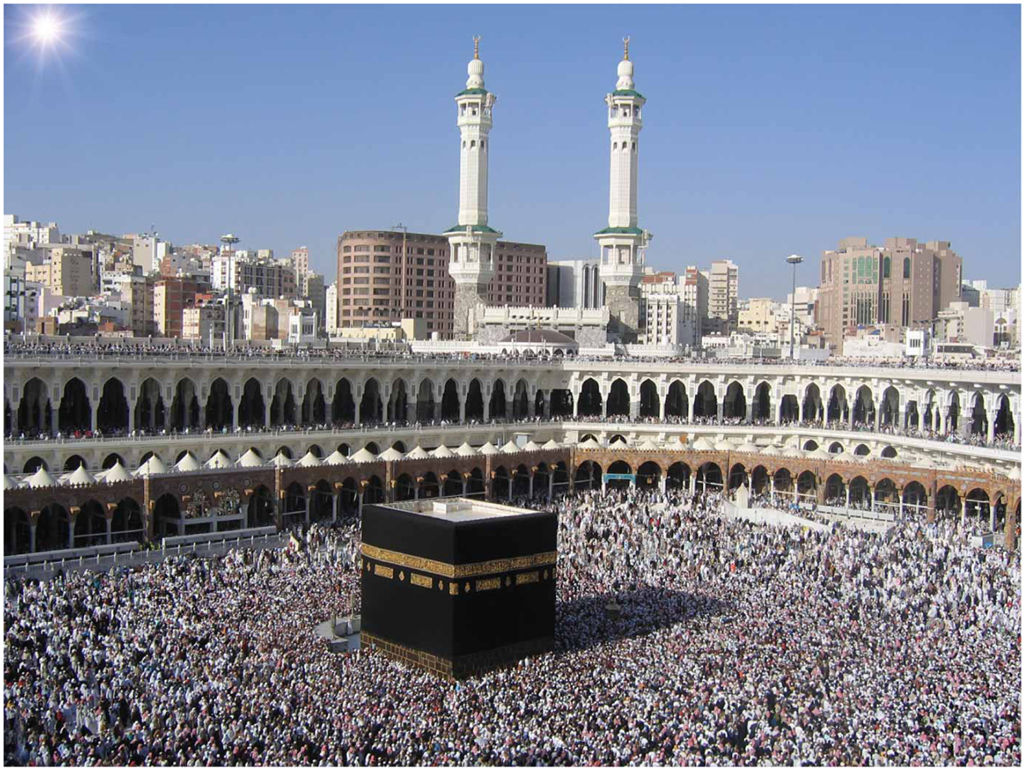

Slide 12
Contested Space
West Bank/Jerusalem
Western (Wailing Wall): remnants of a temple destroyed 2000 years ago
Dome of the Rock; Al Asqa Mosque
Church of the Holy Sepulchre
Ancient Buddha images in Afghanistan

Slide 14
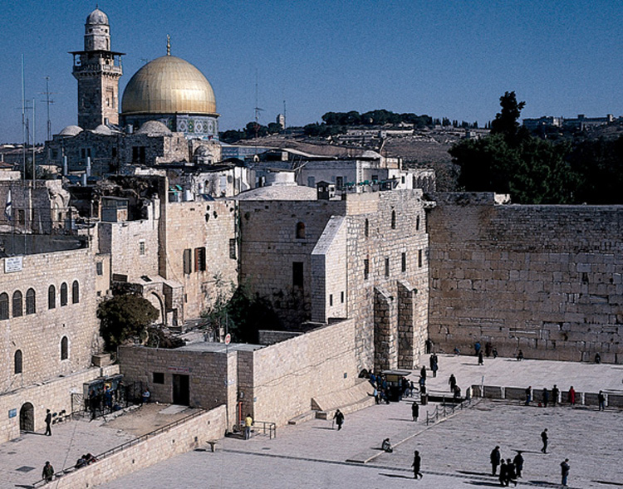
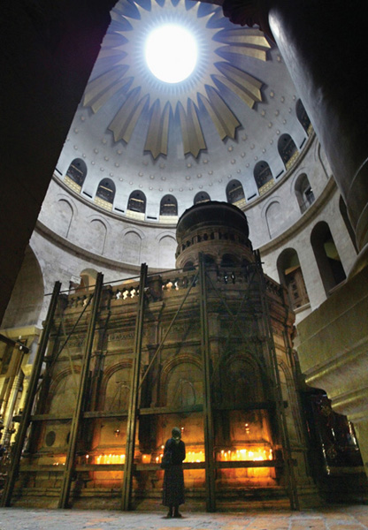
Sacred Sites of Jerusalem
Jerusalem is sacred to three major religions:
Judaism (Western Wall)
Christianity (Church of the Holy Sepulchre)
Islam (Dome of the Rock)

Slide 15
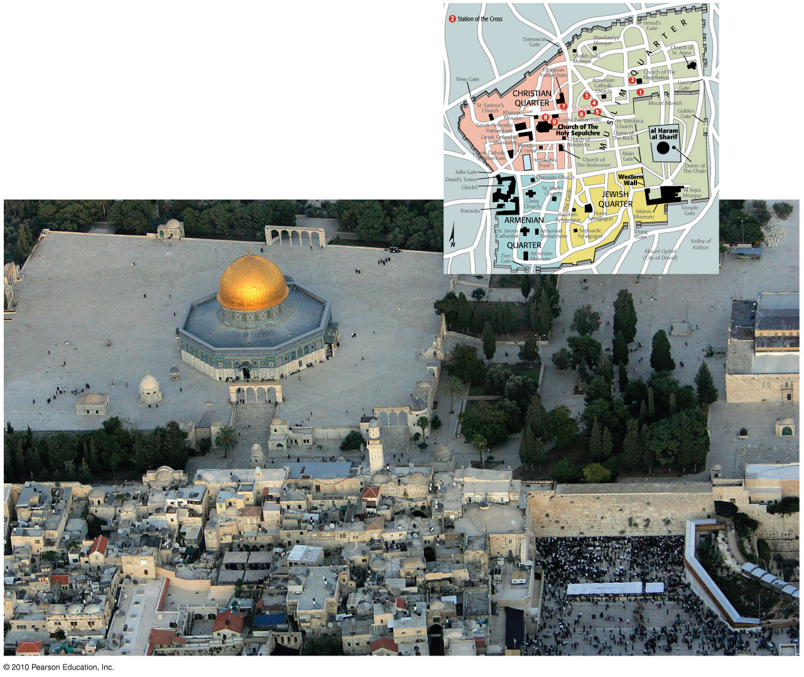

Slide 16
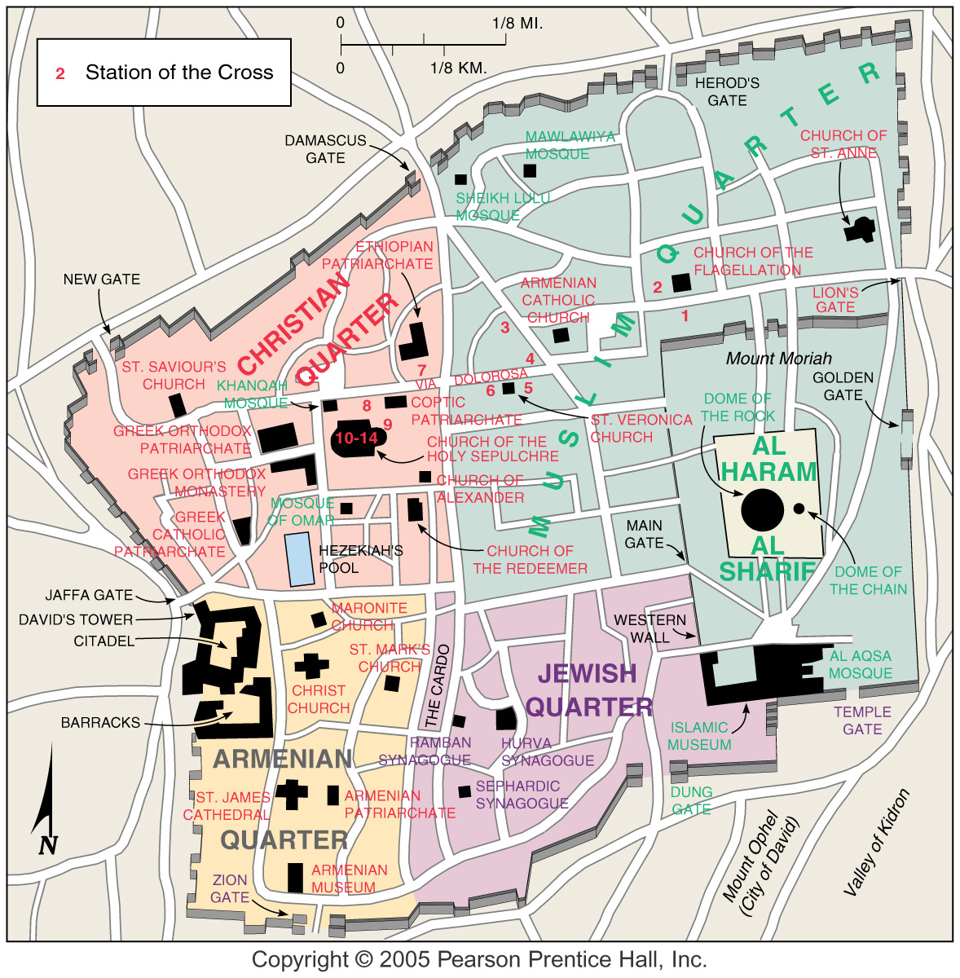

Slide 18
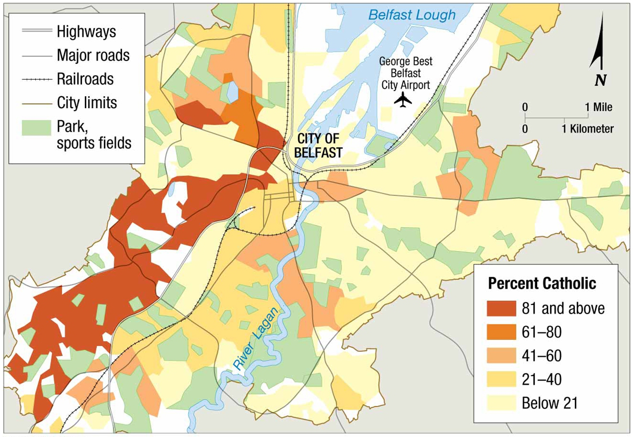

Slide 19
Other landscape influences
Burial of the dead
How soon after death
Cemeteries
Various types
Annual remembrance days
Day of the Dead
Cremation
Above ground/ornate to simple
Mausoleums (Taj Mahal)
Place names
California missions
Hierarchical structure
Substantial to nonexistent
Religious calendar
Around spiritual founder
Around the seasons
Represent historic events in the life of the religion
Easter: first Sunday after the first full moon that falls on or after the vernal equinox

Slide 20
Religious based conflicts
Religious conflict as an extension of ethnic conflicts since religion is an integral part of ethnicity
Fundamentalism (strict, perhaps literal, interpretations of ones principals) Different from extremism
Reject secular tendencies
Doctrinal conformity
Found in every dominant religion
Governments: secular vs religious based
Religion as a basic structure of government
Saudi Arabia/Iran Theocracy
Islamic Republic of …..
Secular governments in the Islamic world are rare
Turkey, Indonesia, Algeria, ….
Some governments ban religion entirely – communist states
All others somewhere in between
Secular systems base on a particular religion
Secularism codified

Slide 21
Conflicts as a result of social structures
Caste system
Role of women
Conflicting beliefs in a country
India
Northern Ireland
North Africa (Sahel)
Contested geography
Israel and Palestine
Crusades
Emotions strong
Assassinations

Slide 23
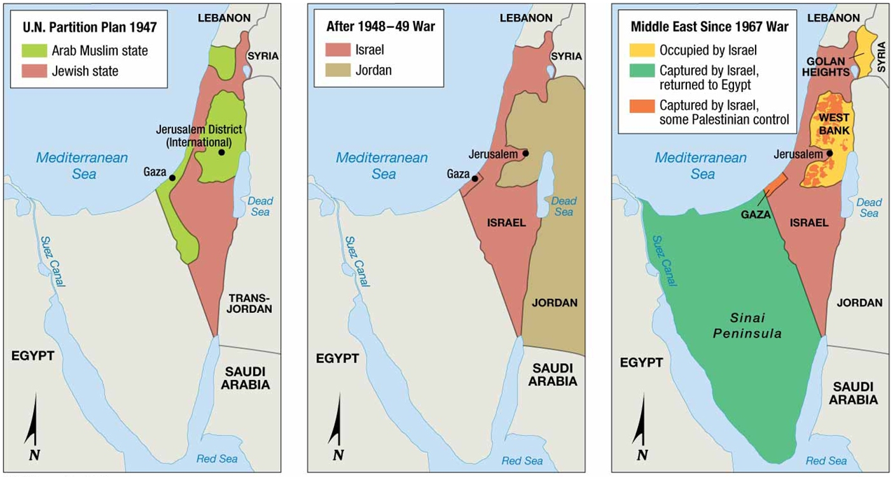

Slide 24
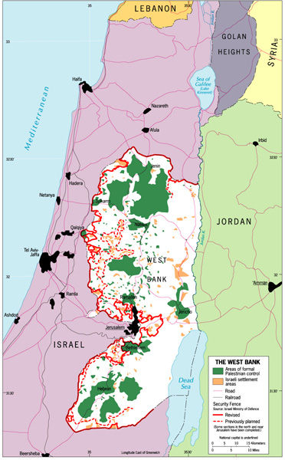
The West Bank with a the proposed security wall, parts of which the Israeli government has already built.

Slide 25
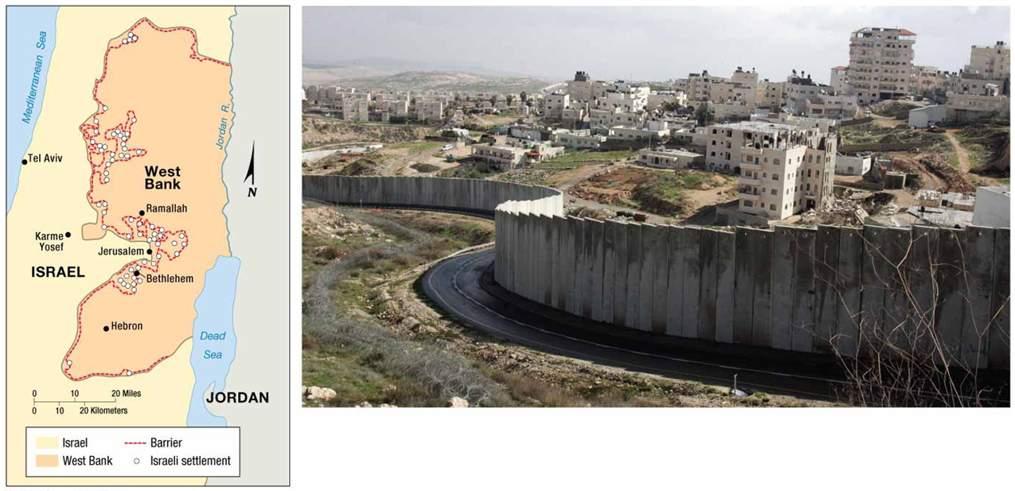

Slide 26
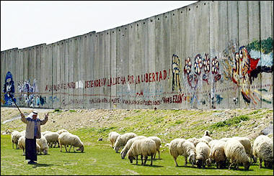

Slide 27
Terms
Ethnic religion
Fundamentalism
Hierarchical religion
Monotheism
Pilgrimage
Polytheism
Universalizing religion

